Slide 1

The Political Economy of Bundling Socio-Technical Innovations to Transform Agri-Food Systems
Christopher B. Barrett
Cornell University
AAEA annual meetings
Washington, DC
July 24, 2022

Slide 2

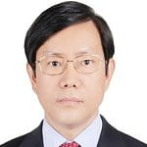
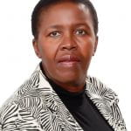








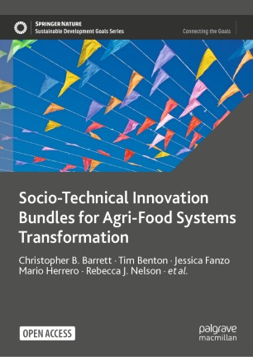



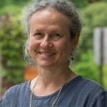








This chapter builds on the open access book from the 2020 Cornell Atkinson – Nature Sustainability expert panel, a diverse group of 23 experts from across disciplines, regions, organizations, etc., w/10 additional co-authors.
Based on the”, released Dec. 2020.

Slide 3
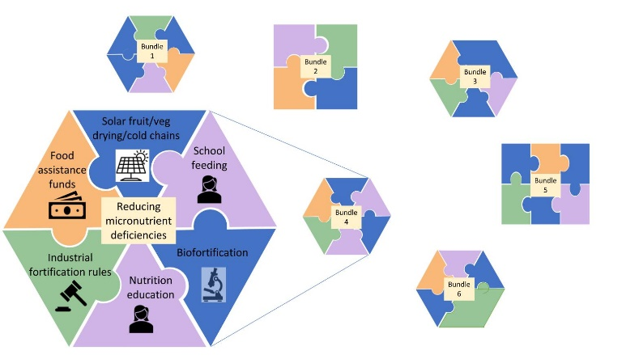
Why STIBs?
Why socio-technical innovation bundles?
  No magic bullets exist. Multiple constraints; relaxing just one limits progress. Must realize synergies to adapt/scale.
  Heterogeneous needs require bundled solutions
  Must address political economy of spillovers, creative destruction and heterogeneous interests. Bundling enables coalitions that can overcome incumbent status quo bias.
  The main obstacle to AFS transformation is not supply of suitable innovations. It is the political economy of diffusing/scaling context-appropriate innovations.

Slide 4
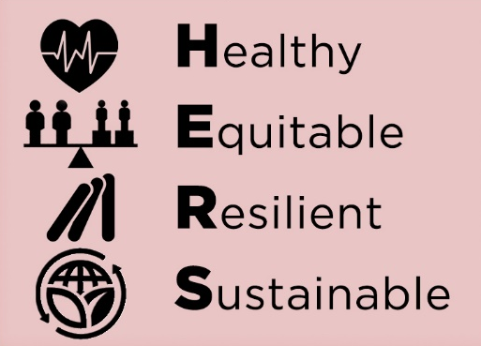
Why STIBs?
The political economy need for STIBs arises because:
Multiple objectives & heterogeneous preferences/interests
Innovations inevitably generate both losers & winners.
This naturally generates resistance to innovations (due to stochastic dominance), especially given differential sensitivity to headwinds than tailwinds. Innovations offer only potential Pareto improvements.

Slide 5
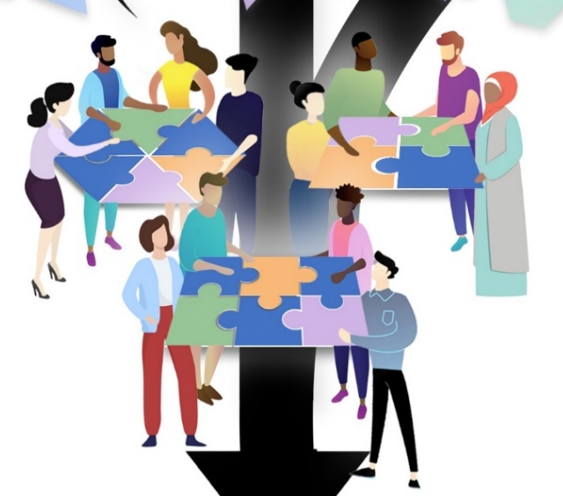
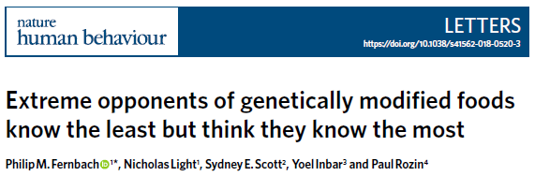
Building Coalitions
Bundling innovations can turn potential Pareto improvements into actual Pareto improvements. One innovation that satisfies the Kaldor-Hicks compensation criterion can compensate for another. So bundle together to form coalitions to overcome humans’ innate conservatism.
This requires coordinated human agency, i.e., sound institutions that both empower all and hold all accountable. Excessively concentrated power commonly obstructs coalition formation. Logic of collective action can also lead to minority interest group domination.
Misinformation another big challenge to coalition formation b/c impedes identification of potential PIs. Fosters subjective uncertainty and conservative opposition to innovations.
Trust is central to coalition formation and maintenance.
Co-creation of STIBs can build trust.

Slide 6
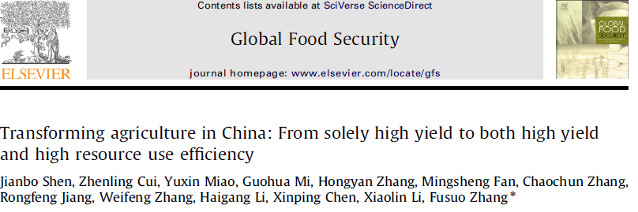
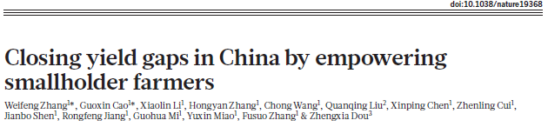
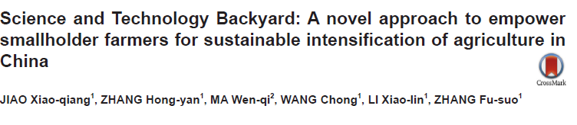
Ex 1: China’s Science and Technology Backyards
Started in 2009, participatory research and extension program at (huge) scale.
Brought together different interest groups - researchers, farmers, commercial input suppliers/traders, local gov’ts – to identify and evaluate contextualized innovation bundles.
Good example of both (i) localized co-creation as a trust-building process, and (ii) logic of collective action in coalition formation: strength of small interest groups + numbers of large latent support groups.
Ultimately, 127 STBs in 23 provinces and engaging 10s millions farmers. Accelerated discovery, diffusion and impacts.
(For more details, see http://chinastb.com/ .)

Slide 7
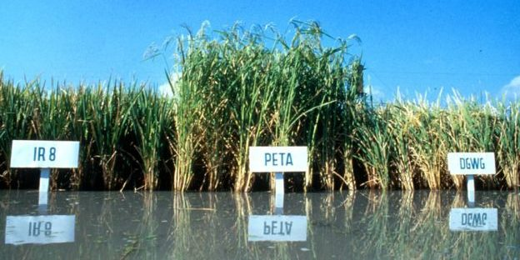
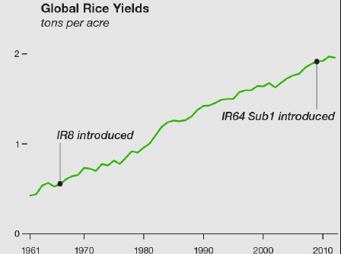
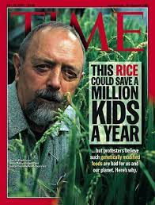
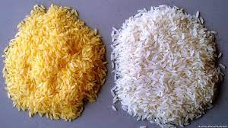
Ex 2: Genetic Improvement in Rice in Asia
Story of Green Revolution rice is inspiring. But success was not inevitable. Had to overcome initial resistance by building coalitions to support diffusion of new varieties. Took a coalition of champions for different, complementary innovations – irrigation, new varieties, electrification, roads, marketing and price stabilization policies, etc.
By contrast, transgenic golden rice, still has not had any measurable impact >20 years after its discovery. Big obstacle: misinformation and logic of collective action favoring an opposition movement.

Slide 8
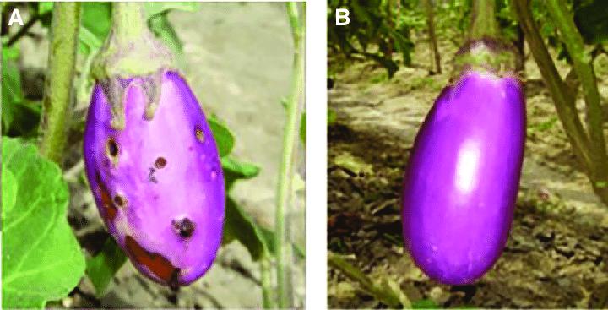
Ex 3: The Irony of
Bt brinjal in South Asia
Transgenic brinjal (eggplant) developed in India to resist borers. Obstructed in India by anti-GM movement, based largely on misinformation and campaign playing to intrinsic conservativism. Moratorium imposed by Minister of Environment and Forests despite approvals concluded Bt brinjal safe and beneficial and despite past approval of Bt cotton in India. Harder to build coalition for brinjal than cotton.
Bt brinjal was Bangladesh’s first GM crop release.
Pesticide importer not exporter. Pushed labeling to address concerns
about farmer choice and information.
The political economy of coalition building explains the differential uptake of Bt brinjal between India and Bangladesh.

Slide 9
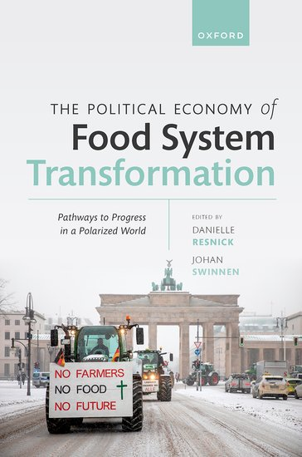
Thank you
Congratulations and thanks to Danielle and Jo … and to all contributing authors.
A must read book!

